Slide 1
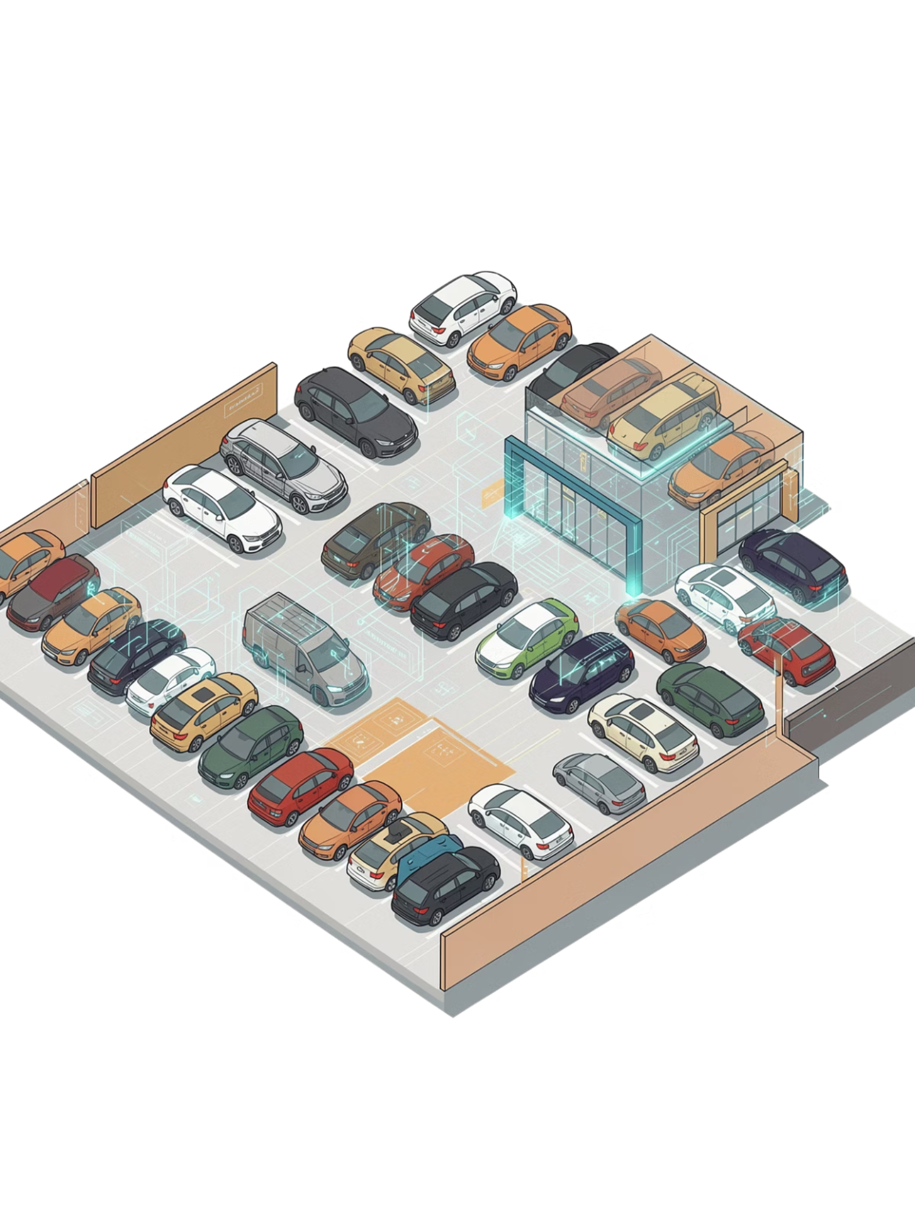
AI-Based Used Car Price Prediction System
Using Natural Language Processing and Machine Learning
Team: 2510030276 – Srija
2510030256 – Navya
2510030068 – Kiran
2510030140 – Anirudh
Supervisor: Subhranginee Das
Department: Computer Science & Engineering
Academic Year: 2026–2027

Slide 2


Problem Statement
Structured Vehicle Factors
Unstructured Text Signals
Used-car prices depend on multiple measurable attributes:
Seller descriptions may contain valuable information often ignored by traditional models:
Vehicle age & mileage
Engine capacity & max power
Fuel type & transmission
Brand, model & seats
Vehicle condition
Ownership history
Maintenance records
Service information
Problem: Develop an ML-based system that combines structured vehicle data with NLP-extracted seller description features to predict used-car selling prices.

Slide 3
Motivation for NLP
Example Seller Description
Useful Signals Extracted by NLP
TF-IDF converts seller text into numerical feature vectors that are fused with structured vehicle attributes.
"Single owner, well maintained, regularly serviced."
Raw text like this carries rich pricing signals — but ML models cannot read words directly. NLP bridges that gap.
Condition
Ownership
Maintenance
Well maintained → positive quality indicator
Single owner → lower depreciation signal
Regularly serviced → higher reliability score

Slide 4
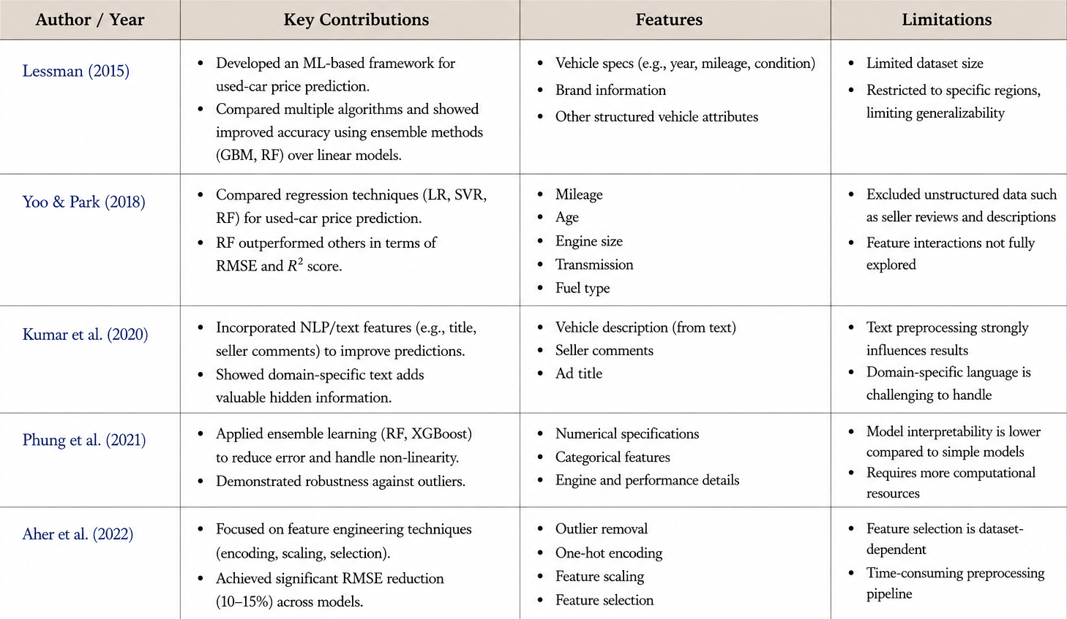
DEPTH AND QUALITY OF LITERATURE REVIEW

Slide 5
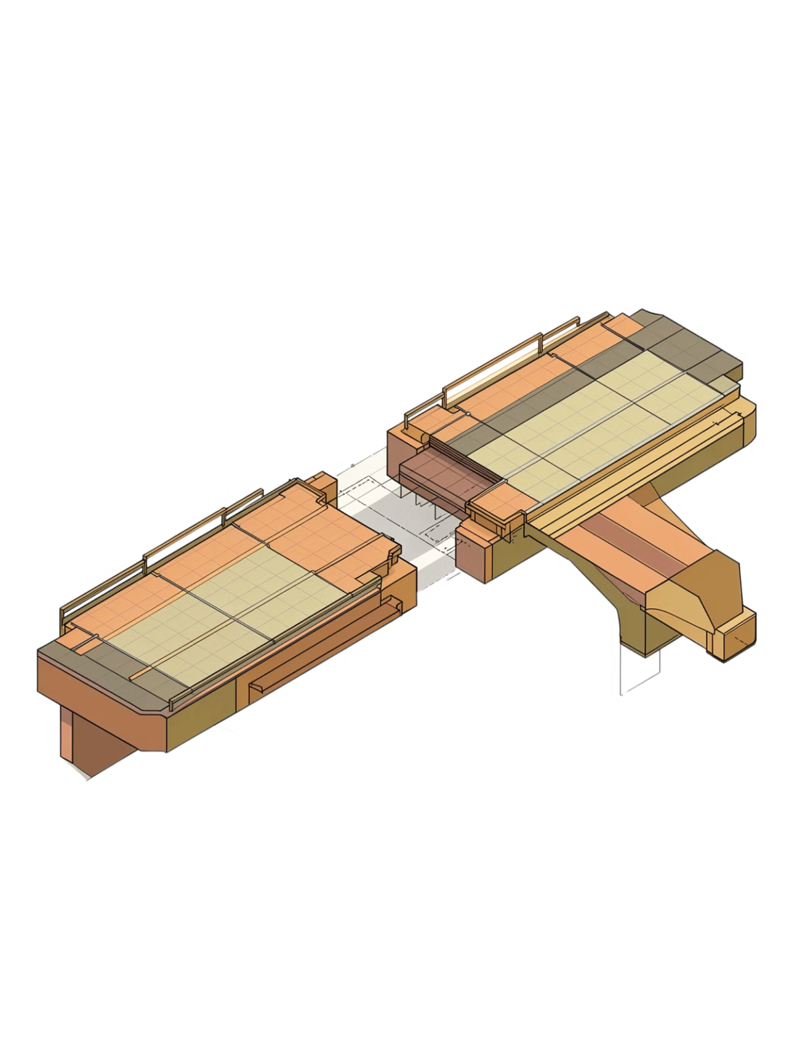

Research Gap
Structured-Only Approaches
Most existing used-car prediction systems rely exclusively on structured numerical and categorical attributes, leaving text data unused.
Untapped Text Signals
Seller descriptions contain additional information about condition, ownership history, and maintenance that structured fields do not capture.
NLP Preprocessing Required
Text information must be cleaned, tokenized, and vectorized before it can be consumed by ML regression models.
Proposed Hybrid Approach
Combining structured vehicle features with NLP-derived TF-IDF features offers a more comprehensive prediction framework.
Positioning: This is the research gap and motivation for the proposed hybrid system — not a proven experimental result.

Slide 6
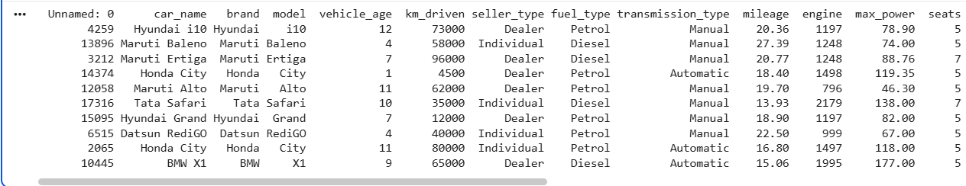
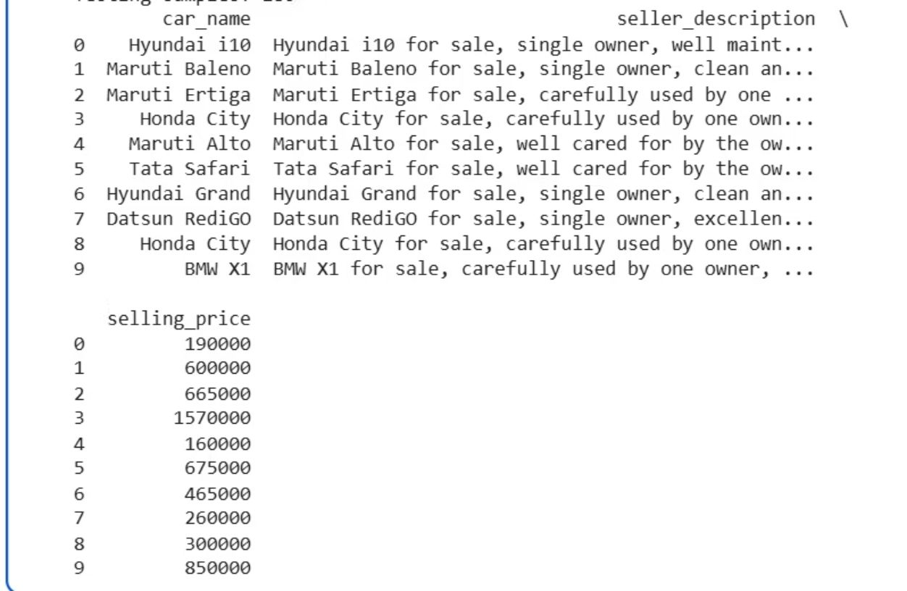

Dataset Description
CARDEKHO USED-CAR DATASET
Structured Vehicle Features
Identity: car_name · brand · model
Usage: vehicle_age · km_driven · seats
Specs: mileage · engine · max_power
Type: seller_type · fuel_type · transmission_type
Text Feature: seller_description | Target: selling_price
Dataset reduced to 900 records for academic implementation. The seller_description column is a synthetic/augmented text component created for the NLP prototype — not original CarDekho seller-written descriptions.

Slide 7
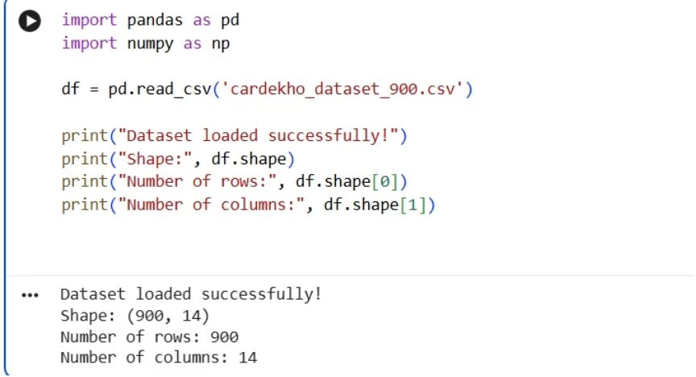
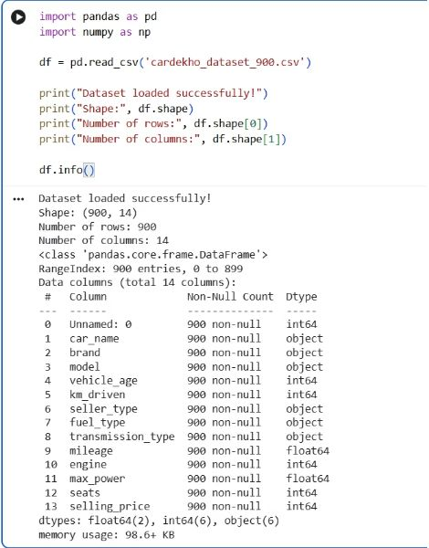
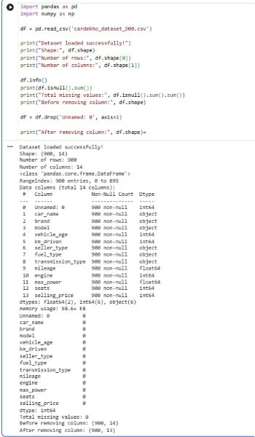
Data Preprocessing
Implementation Evidence
Preprocessing Pipeline
1
Dataset Loading & Understanding
2
Missing Value Check
3
Remove "Unnamed: 0" Column
4
Duplicate Check & Handling
5
Statistical Analysis
6
Feature & Target Separation
7
Categorical Encoding & 80:20 Split

Slide 8


NLP Preprocessing Pipeline
Seller Description
Lowercase
Remove Punctuation
Tokenization
Stop-word Removal
Before Processing
After Processing
"Single owner, well maintained, regularly serviced."
"single owner well maintained regularly serviced"
TF-IDF converts the cleaned text into numerical feature vectors weighted by term frequency and inverse document frequency, enabling ML models to leverage seller description signals alongside structured vehicle attributes.
[Leave space for NLP / TF-IDF screenshot when available]

Slide 9
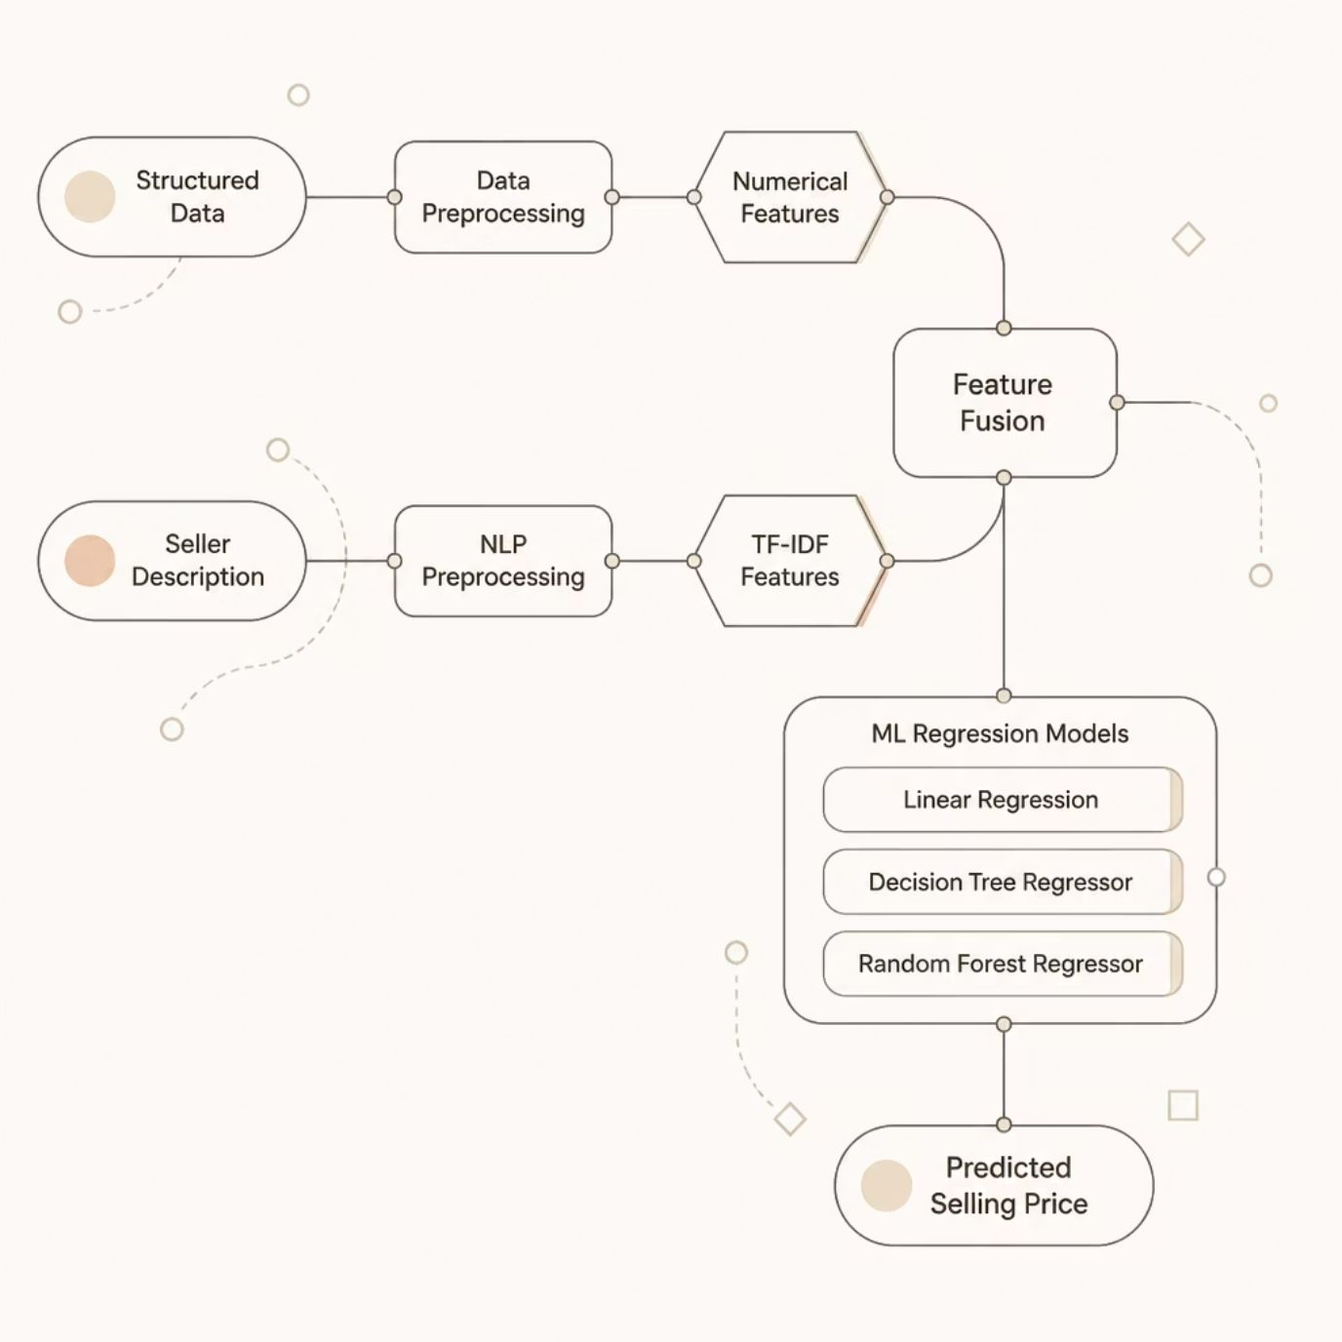

Hybrid ML Architecture
Regression Models
1
Linear Regression
Baseline model; interpretable coefficients for each feature.
2
Decision Tree Regressor
Captures non-linear relationships; easy to visualize splits.
3
Random Forest Regressor
Ensemble of trees; robust to overfitting; expected best performer.
Model performance values (MAE, RMSE, R²) will be added after experiments are complete.

Slide 10
Exploratory Data Analysis
The following EDA visualizations will be populated with actual graphs once generated from the dataset. Each plot is designed to reveal key pricing patterns and feature relationships.
Selling Price Distribution
Vehicle Age vs Selling Price
KM Driven vs Selling Price
Histogram showing the spread and skewness of selling prices across all 900 records.
Scatter plot revealing depreciation trends as vehicle age increases.
Correlation between total kilometers driven and the listed selling price.
Fuel Type vs Selling Price
Correlation Heatmap
Box plot comparing price distributions across Petrol, Diesel, CNG, and Electric categories.
Feature-to-feature correlation matrix highlighting the strongest predictors of selling price.

Slide 11
Conclusion
Used-car price prediction can be effectively performed using Machine Learning and regression techniques.
Vehicle age, mileage, fuel type, transmission, engine details, and brand are important factors affecting price.
Feature engineering and preprocessing improve the quality and accuracy of predictions.
Ensemble models such as Random Forest and Gradient Boosting generally provide better results than simple linear models.
Our project uses these findings to build a reliable used-car price prediction model and provide estimated prices based on vehicle characteristics.

Slide 12
References for Literature Review
Lessmann, S., & Voß, S. (2017). Car resale price forecasting: The impact of regression method, private information, and heterogeneity on forecast accuracy. International Journal of Forecasting, 33(4), 864–877.
DOI: 10.1016/j.ijforecast.2017.04.003
Pal, N., Arora, P., Sundararaman, D., Kohli, P., & Palakurthy, S. S. (2017). How much is my car worth? A methodology for predicting used cars prices using Random Forest.
This work applies Random Forest to used-car price prediction and studies the effect of vehicle features on price.
Jha, A., Singh, R., Manish, Saifi, I., & Srivastava, S. (2021). Used Car Price Prediction. International Journal of Advance Research, Ideas and Innovations in Technology, 7(4).
Longani, C., Potharaju, S. P., & Deore, S. (2026). Price Prediction for Pre-Owned Cars Using Ensemble Machine Learning Techniques. Recent Trends in Intensive Computing. DOI: 10.3233/APC210194.
Gao, J. (2024). Second-hand car price prediction based on multiple linear regression and random forest. Theoretical and Natural Science, 52, 31–40. DOI: 10.54254/2753-8818/52/2024CH0105

